Slide 1
Scalable Big Data Analytics With Dask
ENGINEERING CLOUD COMPUTING
LUDDY SCHOOL OF INFORMATICS, COMPUTING & ENGINEERING
DILIP, ANIRUDH, SUBHADRA

Slide 2
AGENDA
Problem Statement
Why Dask? Why Cloud?
Why XGBoost for benchmarking?
Proposed Tasks
Dask Cluster Setup and AWS Integration Demo
Benchmarking
Results
Challenges we faced
Learning Outcomes
Thank you note and Conclusion
E516

Slide 3
Problem Statement
Issues:
With approximately 2.5 quintillion bytes of data generated daily.
Data scientists have leveraged traditional tools like Pandas, SciPy, NumPy, and scikit-learn for data analysis.
Out of memory error, training taking forever.
Approach:
Steep learning curve with Hadoop, Spark etc
Introducing Dask, and its integration with Cloud Providers [AWS]
E516

Slide 4
Why Dask?
A powerful Parallel execution framework that scales Numpy, Pandas, and Scikit-Learn with minimal rewriting unlike hadoop and spark.
Can be deployed at scale and also down to a single local instance
A real-time and responsive dashboard that shows current progress, communication costs, memory use, profiling, updated every 100ms
E516

Slide 5
Why XGBoost and Optuna for benchmarking Machine Learning Task?
XGBoost was selected for its scalability and performance in handling large datasets.
Optuna integration enables effective hyperparameter tuning, enhancing model accuracy.
This pairing is well-suited for distributed settings, guaranteeing effectiveness in machine learning assignments.
Xgboost hyperparameters - Huge grid space.
E516

Slide 6
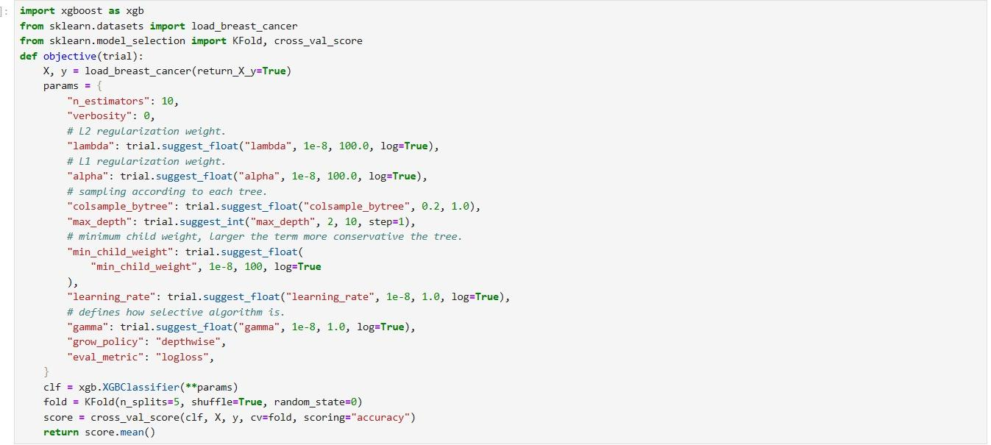
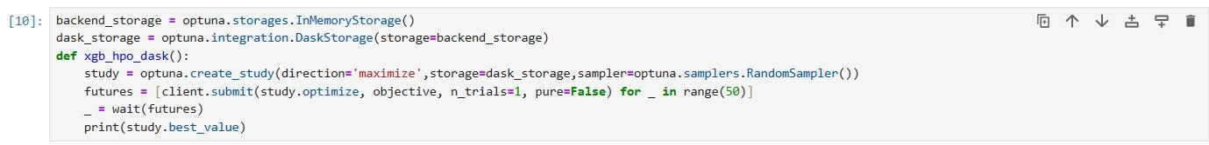
Dask Integration with XGBoost
E516

Slide 7
Proposed Tasks
Setup infrastructure and create a Dask cluster on AWS.
Benchmarking ML performance with XGBoost and Optuna.
Varying number of workers, worker - threads, input data format etc. and perform detailed study.
E516

Slide 8
Dask Cluster Setup
SECTION 2

Slide 9
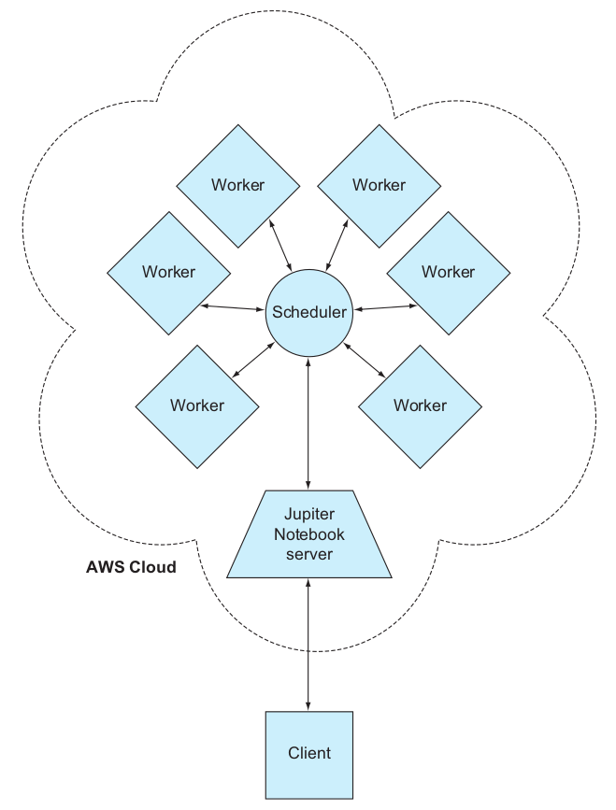
Architecture of Dask Cluster in AWS
The system has four distinct aspects: the jupyter server, the scheduler, the client and the workers. Their roles are as follows:
Jupyter server - A frontend for the user to run code and submit jobs to the cluster
Scheduler - Receives the jobs from the client via the Jupyter server, divides the work to be done, and coordinates the workers to complete the job
Worker - Receives the tasks from the scheduler and computes them
Client - Show the results to the user
E516

Slide 10
The setup process involves five major steps to get the cluster up and running
Set up the ECS cluster.
Arrange the network settings for the cluster.
Establish a shared data drive using Elastic File System (EFS).
Reserve storage, build, and deploy the Docker images within Elastic Container Repository (ECR).
Connect to the cluster.
E516

Slide 11
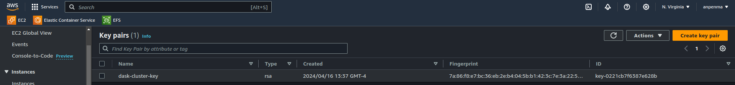
Setting up the ECS Cluster
The first step in this process was to obtain an SSH key that we will use to associate with the EC2 instances that were created by the ECS cluster
E516

Slide 12
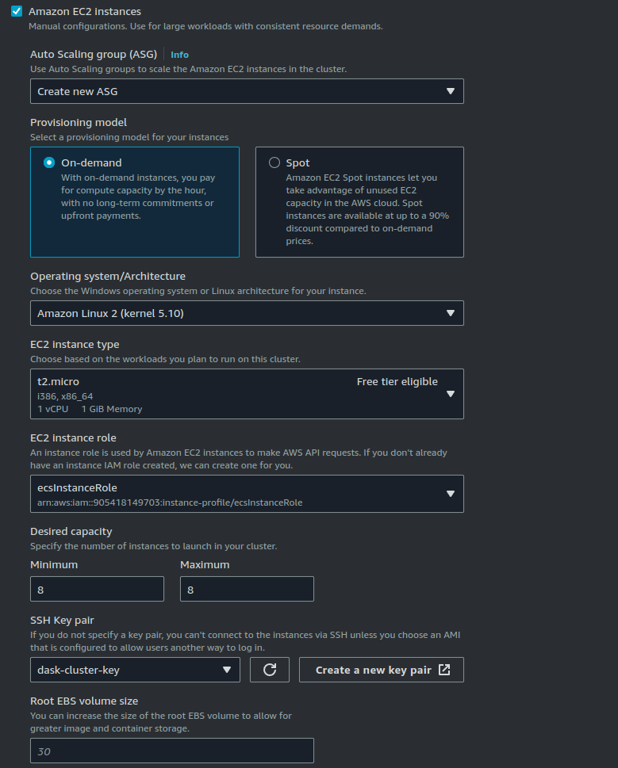
Setting up the ECS Cluster
With the Key Pair saved, next an ECS Cluster was to be created.
This was done using the ECS Create Cluster wizard.
The operating system chosen was Amazon Linux 2.
Next for the EC2 instance type, we went with the t2.micro which was under the eligible types in the free tier.
Following this a total of 8 instances were specified as the desired capacity.
The Key-pair was specified as the one created earlier. Rest of the options were default. With this we had ECS start 8 instances under the name of dask-cluster.
E516

Slide 13
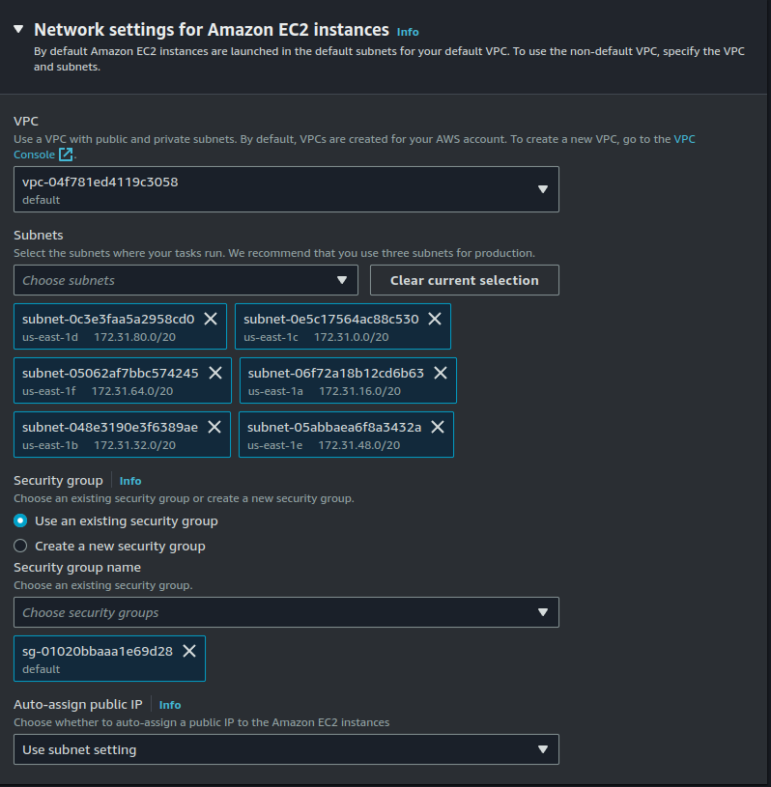
Setting up the ECS Cluster
Rest of the options were default. With this we had ECS start 8 instances under the name of dask-cluster.
E516

Slide 14
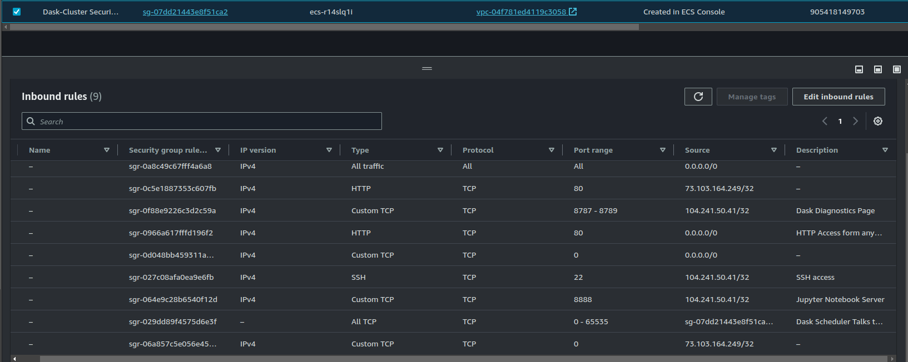
Arrange the Network Settings for the Cluster
With the cluster running and the cluster’s firewall rules needed to be configured so we can ssh to it. When ECS creates a cluster, it will automatically create a security group for it in EC2. So here a few inbound rules were added.
E516

Slide 15
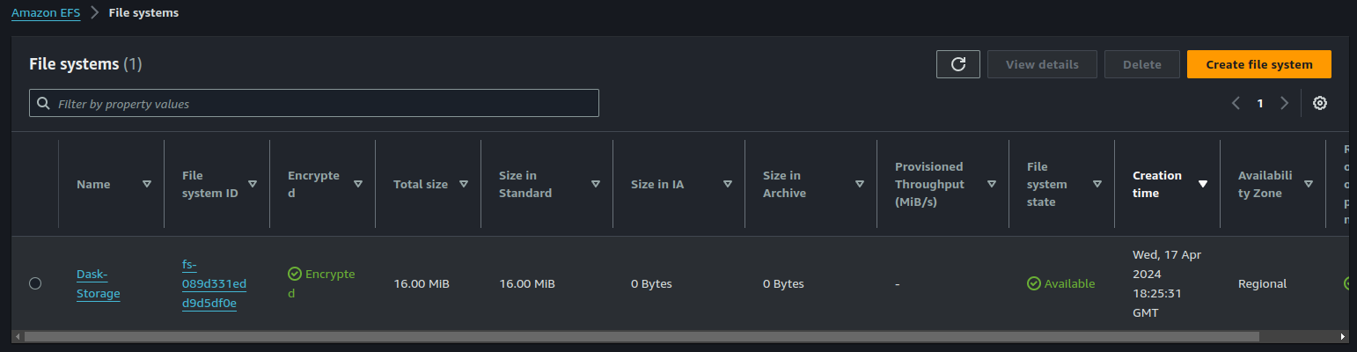
Establishing a Shared Data Drive in using Elastic File System (EFS)
Most things with instances in a cluster are temporary like its ip address and compute resources. But if we want persistent storage, we have to leverage the Elastic File System in AWS.
E516

Slide 16
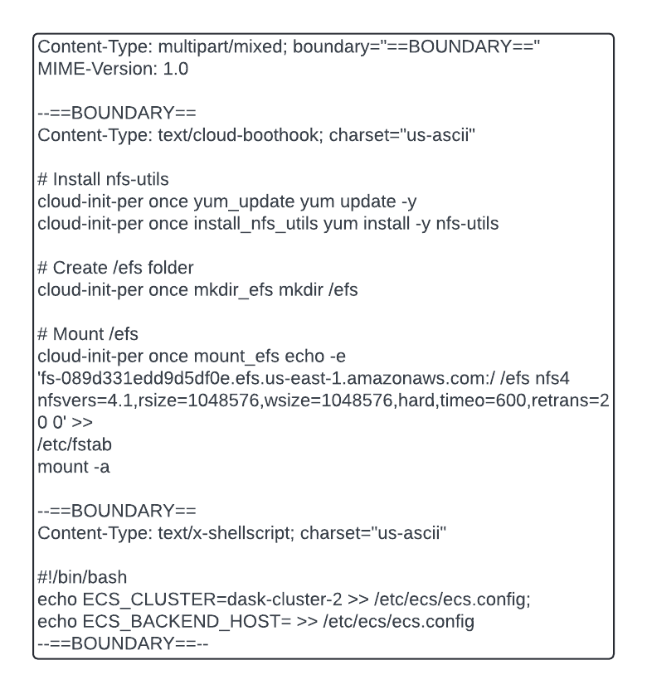
Launch Template
Next, we had to create a Launch template that is to be provided to the auto-scaling group for automatically launching the instances.
For this we copied an existing ECS template and modified the security group and provided the below code to be run on startup for each instance which includes the DNS for the file system and cluster they need to be associated to
E516

Slide 17
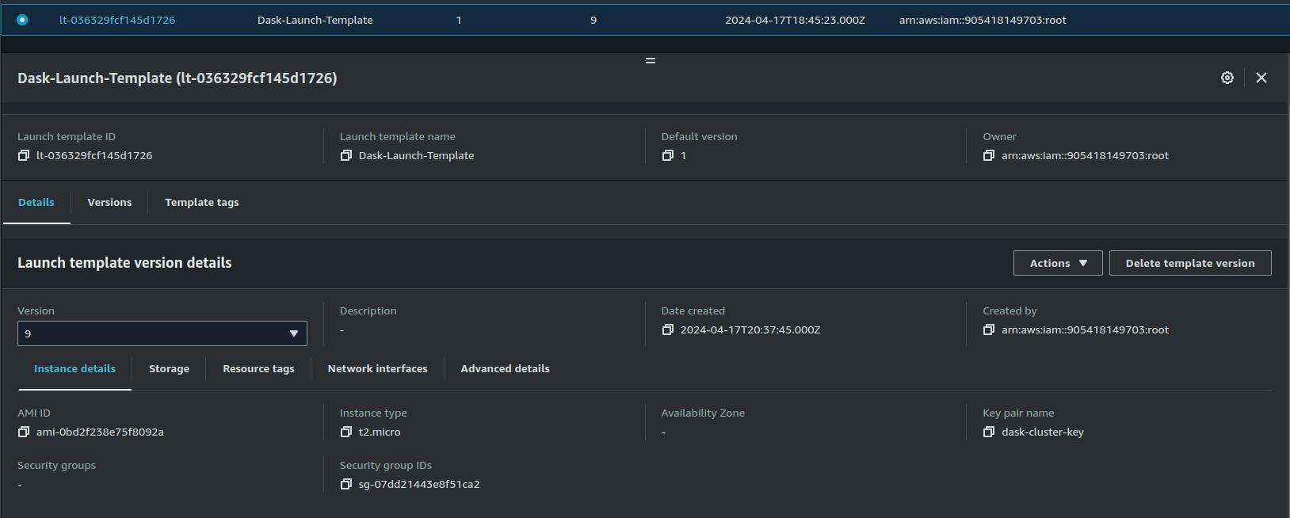
Launch Template
E516

Slide 18
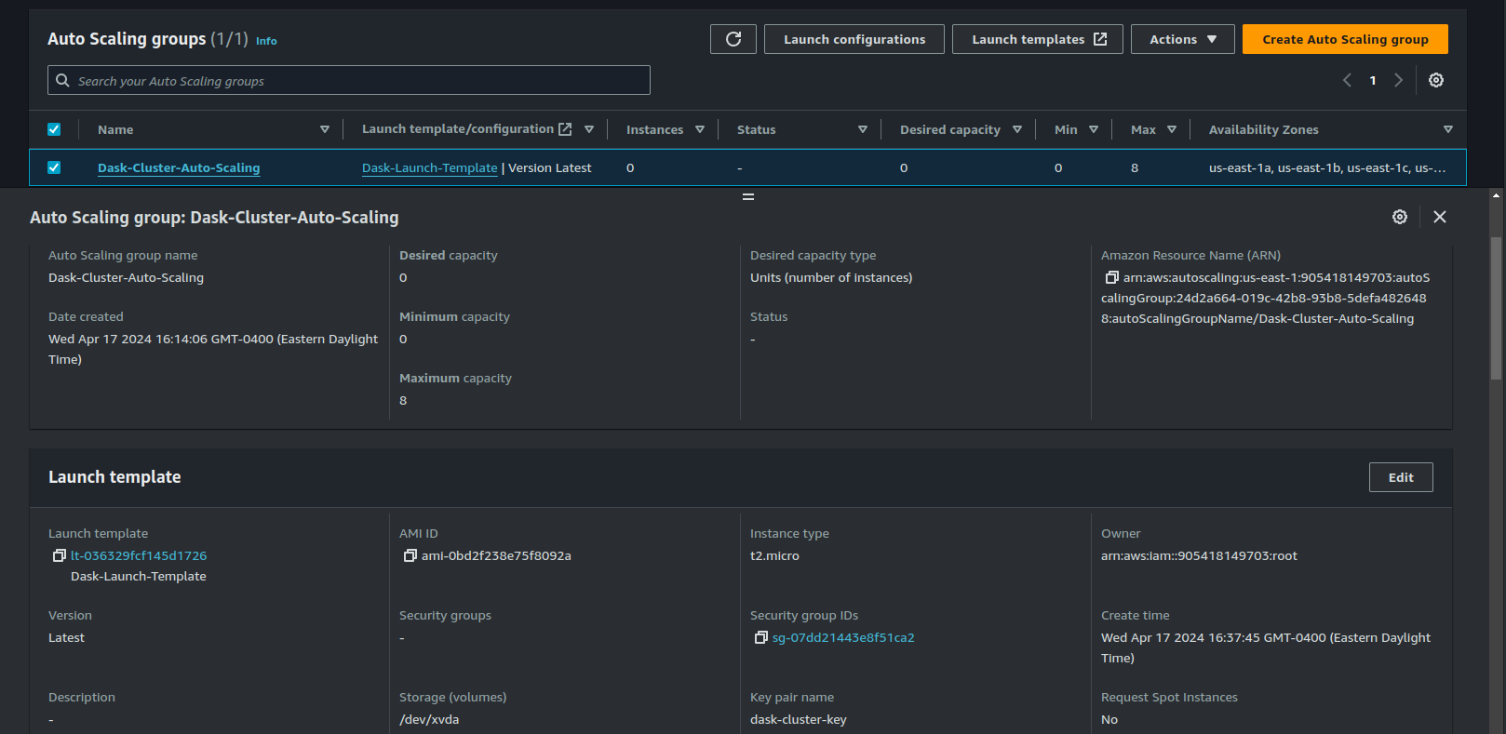
Auto-Scaling Group
With the launch template created, the next step involves supplying it to the auto-scaling group. For the auto-scaling group creation, a few inputs were given such as VPC, launch template, subnets, and group size. With this we could finally start the auto-scaling feature working after terminating all the old instances.
E516

Slide 19
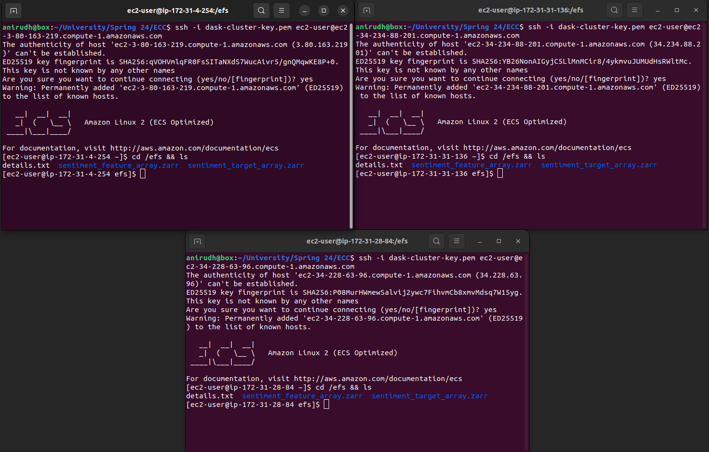
Testing if EFS mounted successfully
Once all the instances were running, a test had to be performed to check whether the EFS drive had been successfully mounted onto all the instances. For this using a file was sent to an instance using the scp from a local system. Once it was sent, the expectation was that the file would be in all of the remaining instances. After checking all the instances we were able to confirm that indeed the file was present everywhere.
E516

Slide 20
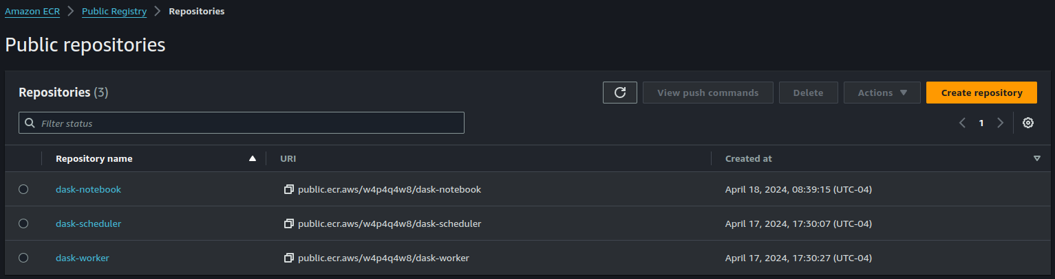
Reserve storage, build, & deploy the Docker images within Elastic Container Repository (ECR)
The purpose of this step is to build our Docker images and upload them into the ECR. Thankfully, AWS has streamlined and simplified the process a lot. But in order for the images to be uploaded via CLI in the local system, first AWS CLI had to be configured in the local machine. This involved creating an IAM user with permission to upload and modify files. With the user created and logged into the AWS CLI, the docker commands to be used were already provided in the ECR under the option push commands and were run in the terminal for each repository separately. There were 3 repositories created for this project: dask-notebook, dask-scheduler, dask-worker.
E516

Slide 21
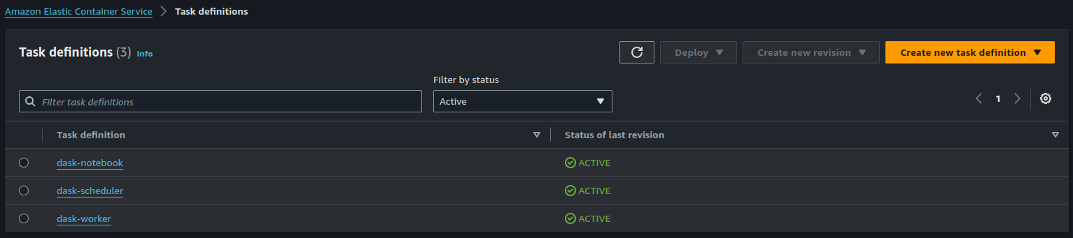
Task Definition
With the docker images in-place, a task definition had to be supplied for the images to be initialized as containers in the instances. Let’s look at the task definition of dask-scheduler as a sample.
E516

Slide 22
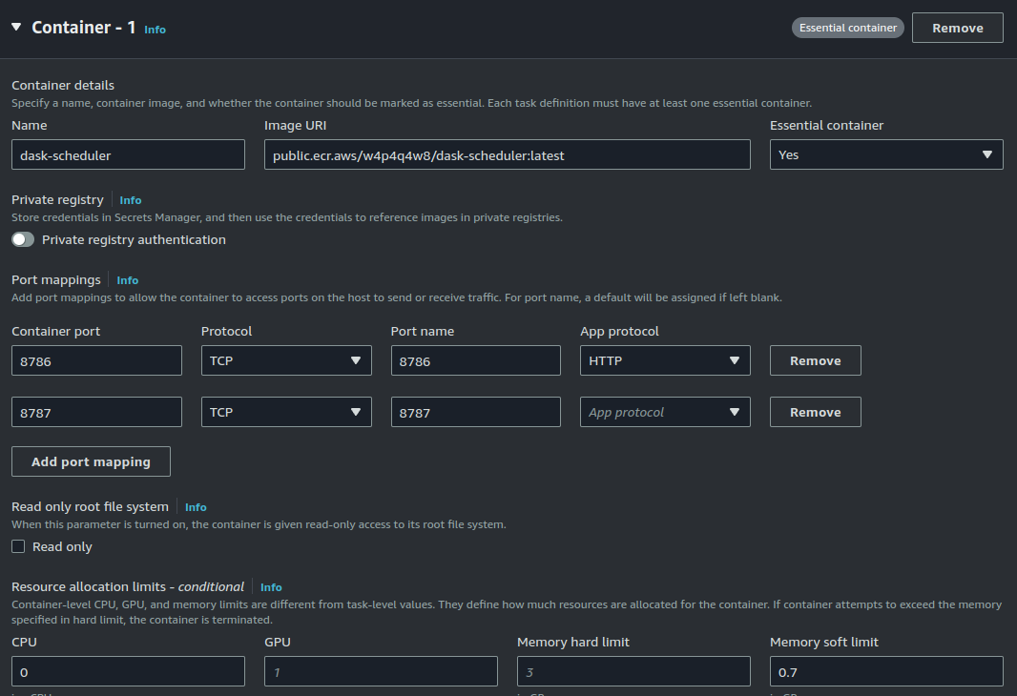
Task Definition
E516

Slide 23
Let’s Connect to the Cluster!
With all these in place, all we have to do now is to connect to the cluster using the public DNS name of the notebook and scheduler to view them on the local browser. The notebook was present on port 8888 and dask’s diagnostics page was located on port 8787. With all of these steps successfully done, we can now connect to the cluster and begin running some jobs. To test this, some sample Dask code will be used that was already provided as part of the Jupyter server.
E516

Slide 24
Benchmarking

Slide 25
Benchmarking
Metrics - CPU time: to measure how fast a piece of code runs.
Wall time : disk I/O, caching, overall time and finally Accuracy measures.
Varying number of workers,worker - threads, input data format [csv, parquet] etc
Observing Task Graphs.
E516

Slide 26
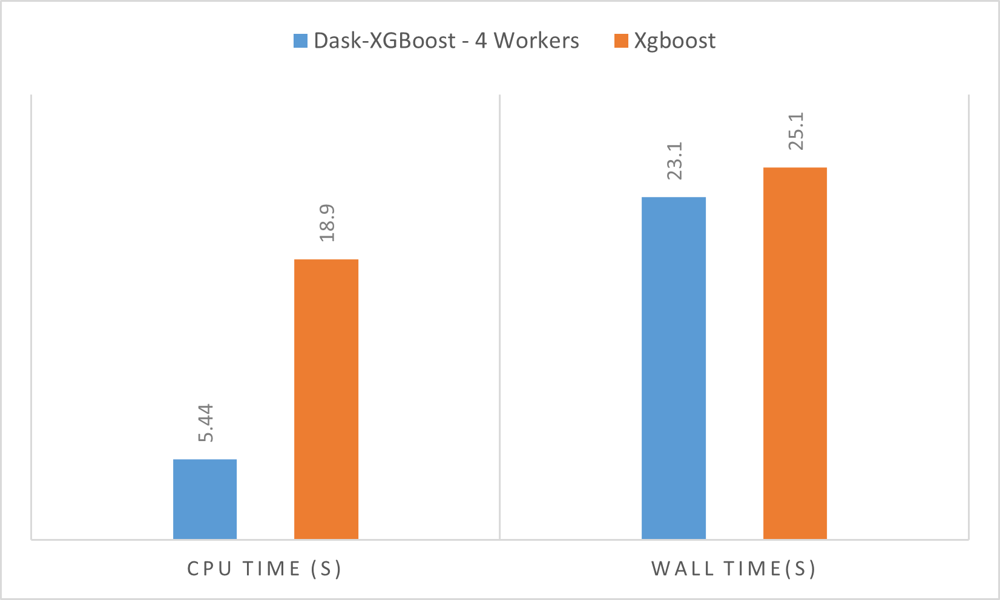
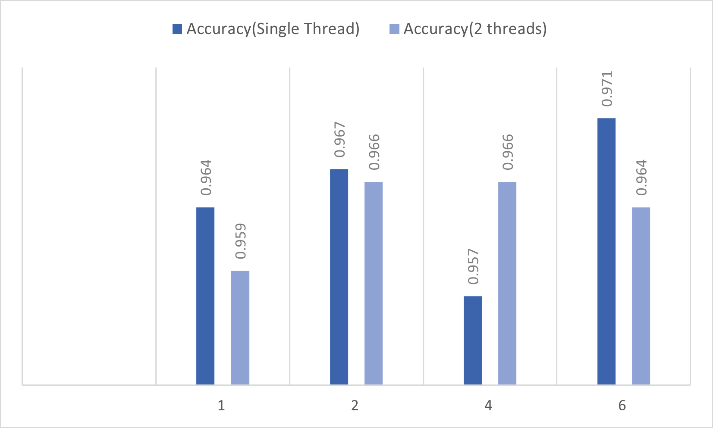
Observations - 1
Parallelized XGboost with Dask vs Vanilla Xgboost.
Accuracies obtained across single and dual threaded worker nodes
E516

Slide 27
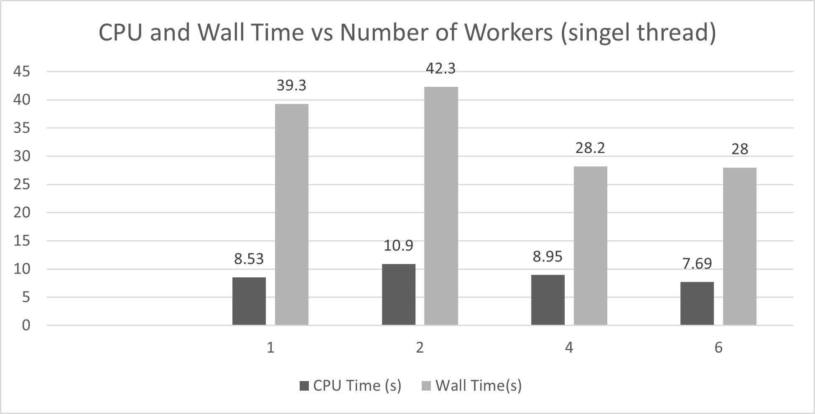
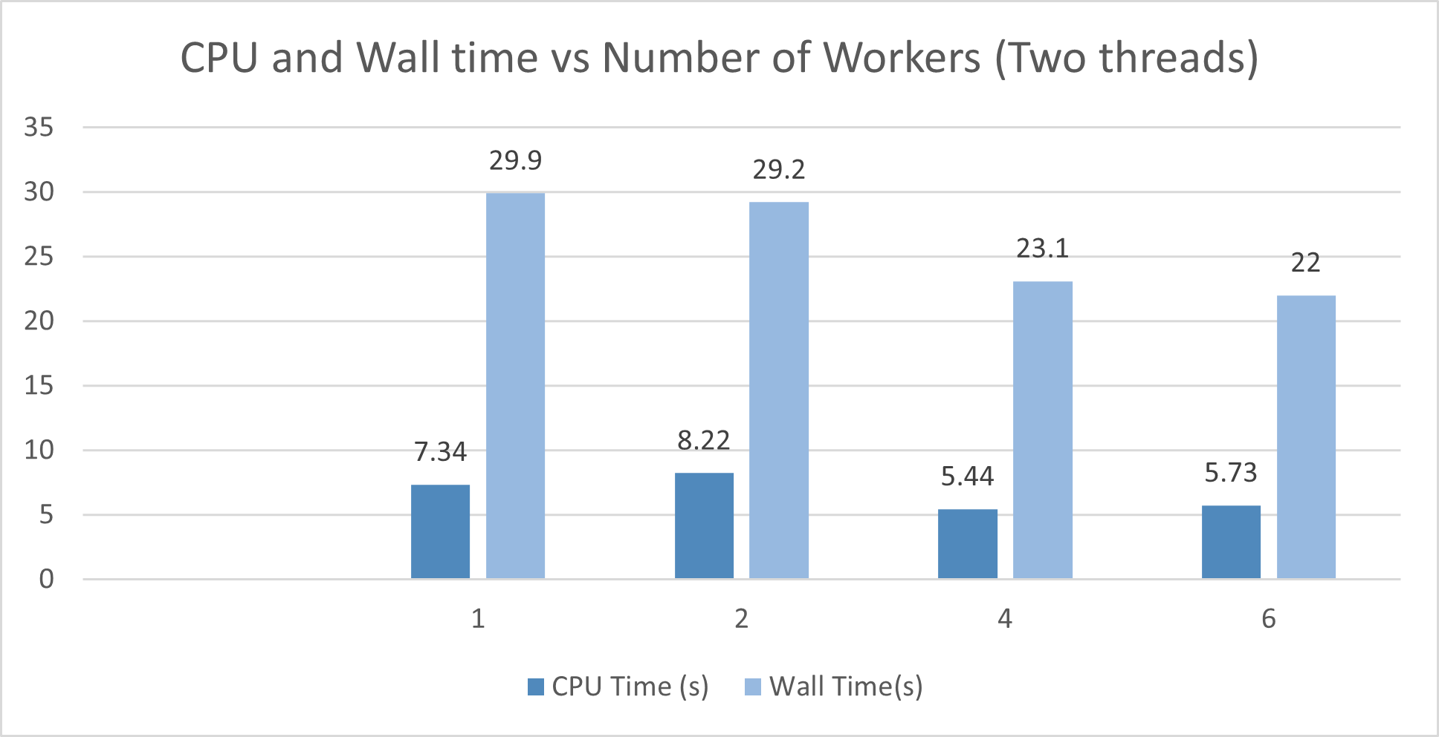
Observations - 2
CPU and Wall time vs Single and dual threads
Reduced CPU and wall times with increasing number of workers
E516

Slide 28
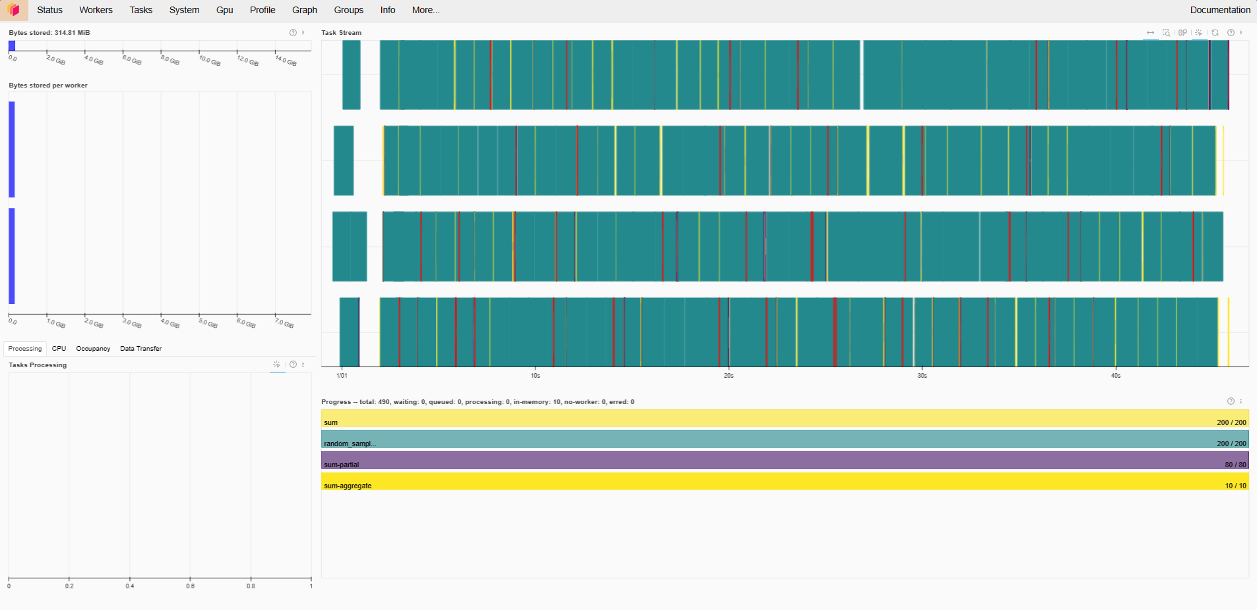
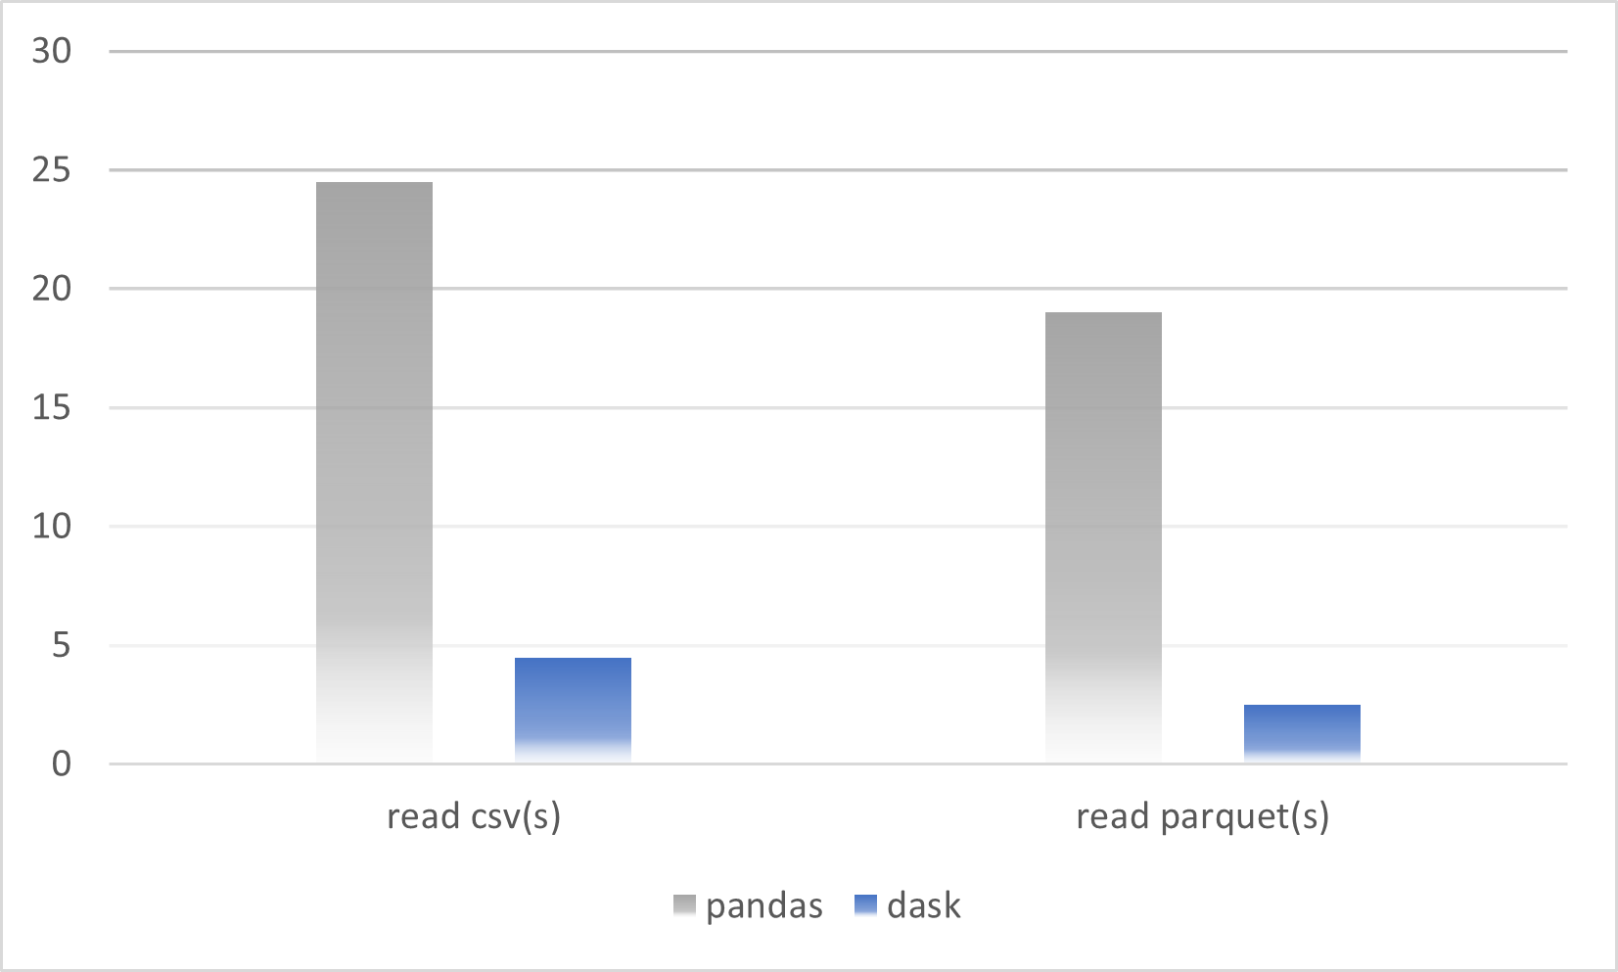
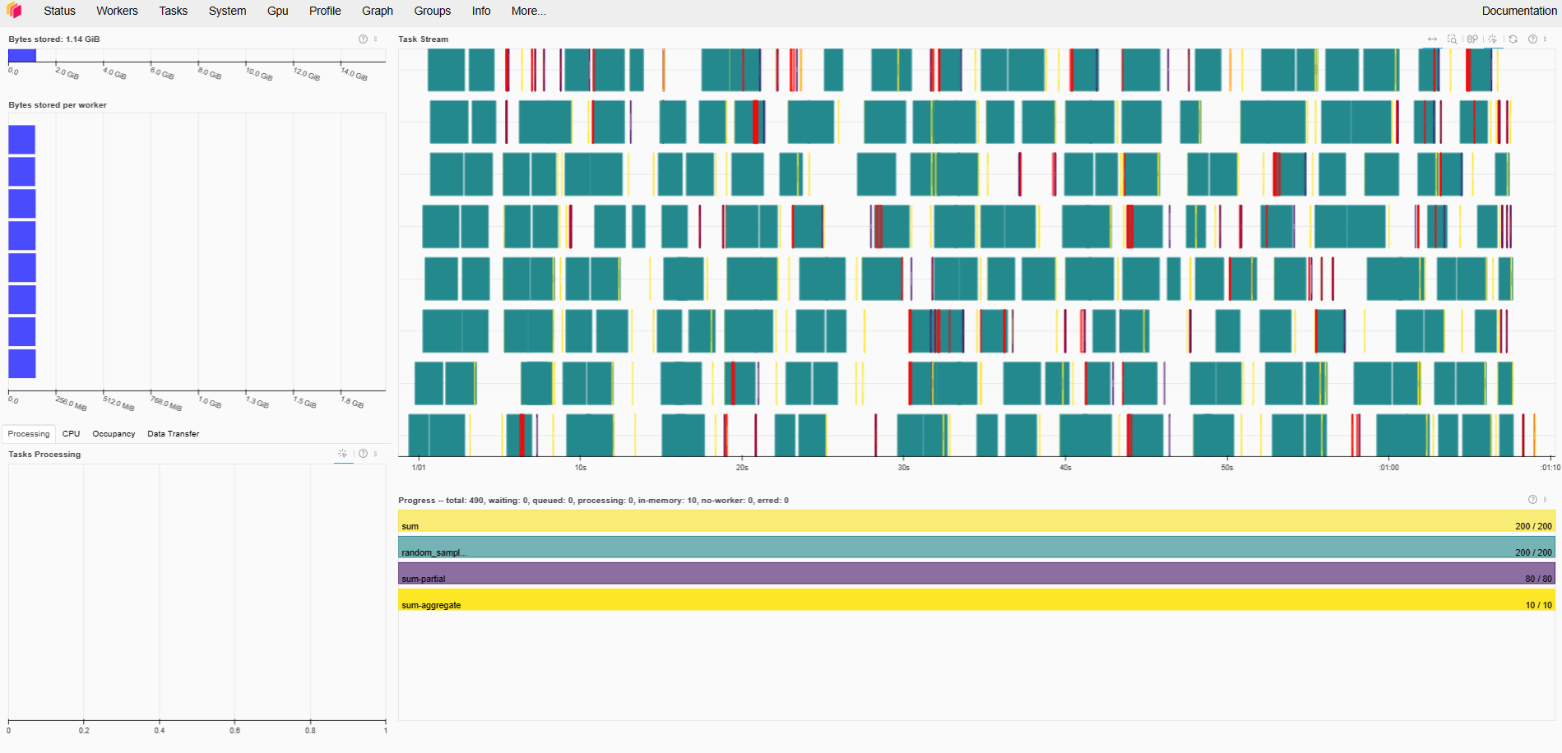
Observations - 3
Pandas vs Dask - Read CSV and Parquet
Task Graphs - efficient parallelization
E516

Slide 29
Results
A highly scalable cloud platform for a team/member that wants to train ML models at scale, or perform analytics on Big Data
A detailed study of Dask. Benchmarking with the traditional Data science frameworks such as Pandas, Scikit Learn, xgboost.
Dask Diagnosing for efficient use of resources.
E516

Slide 30
Challenges
Cluster Setup : Making sure all the worker nodes had the same version of packages used as client and scheduler
Parallelizing XGboost code with dask [multiple ways] - a slight learning curve.
E516

Slide 31
Learning Outcomes
Dask. Better than Pyspark? Hadoop?
AWS,Docker, IAM roles, ECS etc BenchMark studies, picking the right metrics.
Error Logging and making sense of it to find where the system crashed.
Parallelizing XGboost code with dask - a slight learning curve.
Coordinate within the team. Distributed scheduling of tasks based on individual interests
E516

Slide 32
Future Work
Definitely work on benchmarking with data > 50 GB
Compare Dask, Pyspark and RAY.
Programmatic deployment of Dask cluster on AWS and building bigger cluster.
E516 Engineering Cloud Computing

Slide 33
Conclusion
Had an amazing learning curve and good times working in team.
Looking forward to finalizing our report.
Thank you to JZ and JT for their valuable feedback.
E516 Engineering Cloud Computing

Slide 34
Thank you

